Slide 1



Patient risk stratification in dengue with 2D latent space mapping using unsupervised learning
Bernard Hernandez
b.hernandez-perez@imperial.ac.uk
Department of Medicine
Imperial College London
https://bahp.github.io/portfolio-academic/
14th of December 2023
1
Notes:
"Revolutionizing Antimicrobial Decision-Making: Harnessing the Potential of AI and Machine Learning in Integrated Clinical Decision Support Systems”
“Amplifying Healthcare: Unleashing the Power of AI and Machine Learning in Clinical Decision Support Systems” "Elevating Antimicrobial Decision-Making: Empowering Hospitals with AI and Machine Learning in Clinical Decision Support Systems"

Slide 2

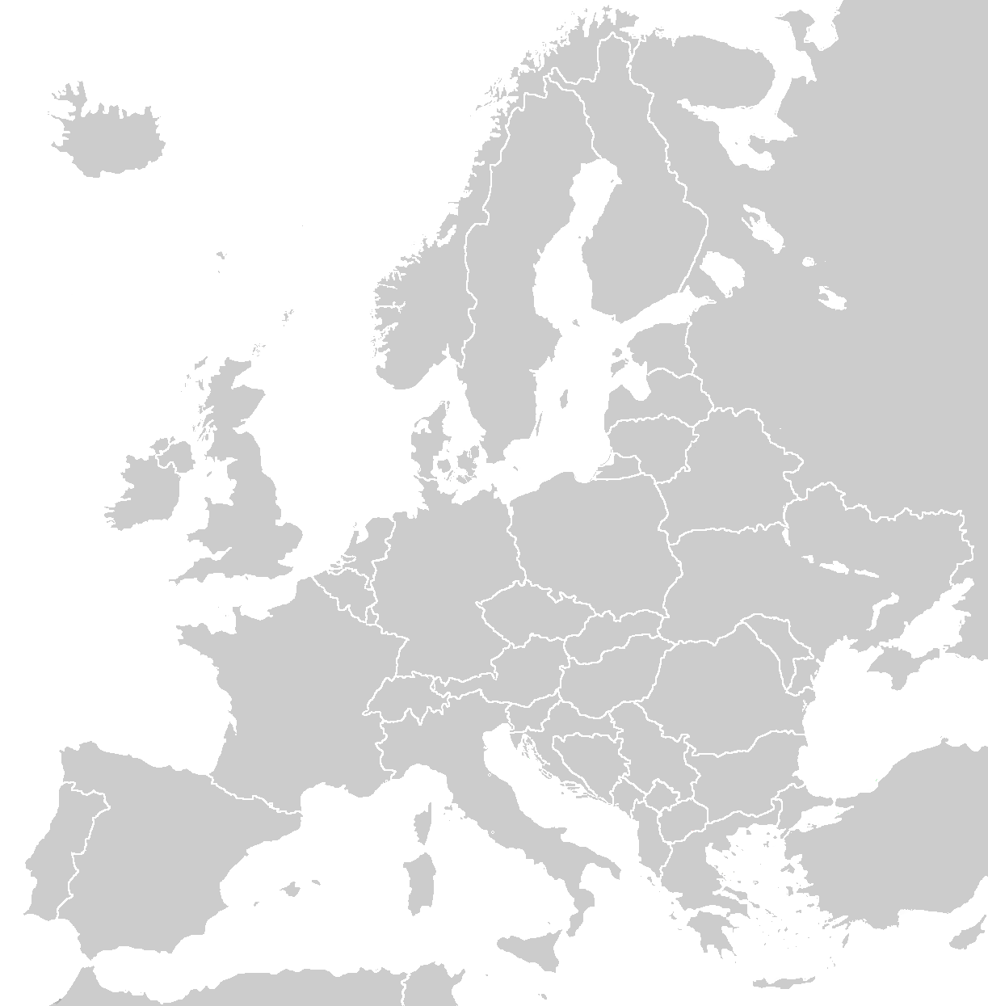





Academic journey
Rey Juan Carlos University (URJC), Madrid, Spain
B.Sc. in Telecommunications
B.Sc. in Computer Science
Royal Institute of Technology (KTH), Stockholm, Sweden
M.Sc. in Machine Learning
Imperial College London (ICL), London, United Kingdom
Ph.D. in Computer Science and Healthcare
Research Assistant
Postdoctoral Research Associate
Postdoctoral Research Fellow

Slide 3
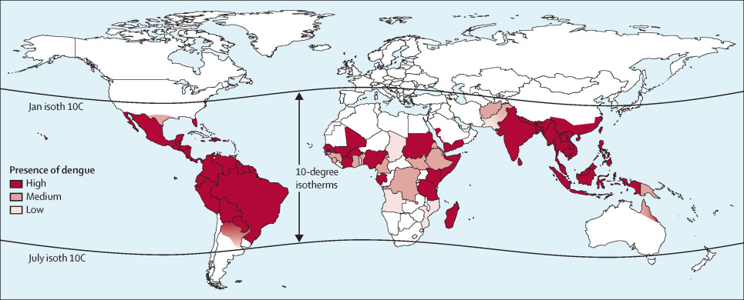
A brief overview of Dengue
Introduction
Dengue fever is a mosquito-borne viral infection.
It is endemic in over 100 countries, with higher prevalence in tropical and subtropical regions.
Approximately 51 million symptomatic cases each year, with seasonal epidemics and high caseloads imposing a huge strain on local healthcare services.
Major public health concern with increasing incidence (research suggesting climate change influences transmission).
G. Guzman and E. Harris – Dengue – The Lancet (2014)
Notes:
Dengue is a mosquito-borne viral infection
Endemic in over 100 countries, with a higher prevalence in tropical and subtropical regions.
Approximately 51 million symptomatic cases each year, with seasonal epidemics and high caseloads imposing a huge strain on local healthcare services.
Wide spectrum and non-specific nature of clinical symptoms, confused with other febrile illnesses.
Major public health concern with increasing incidence
Management is basically supportive care, with vaccines so so..
Usually, worse outcomes in children and young adults
Need to identify patients at increased risk of complications such as bleeding or hock.

Slide 4
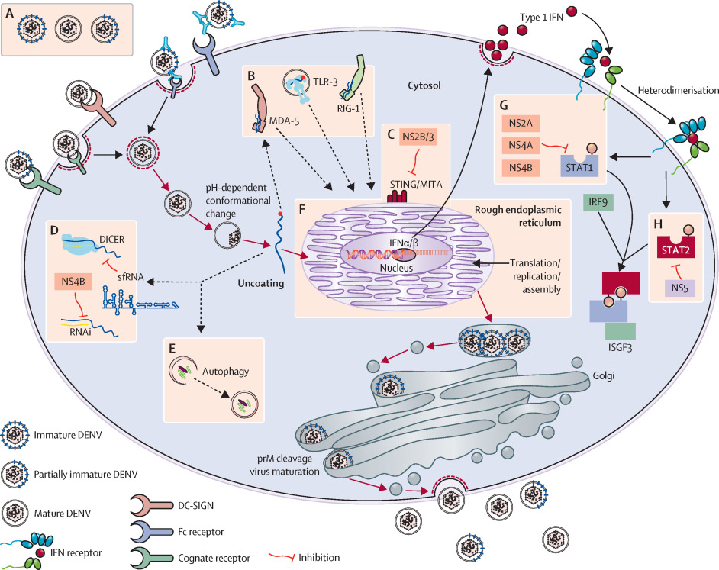
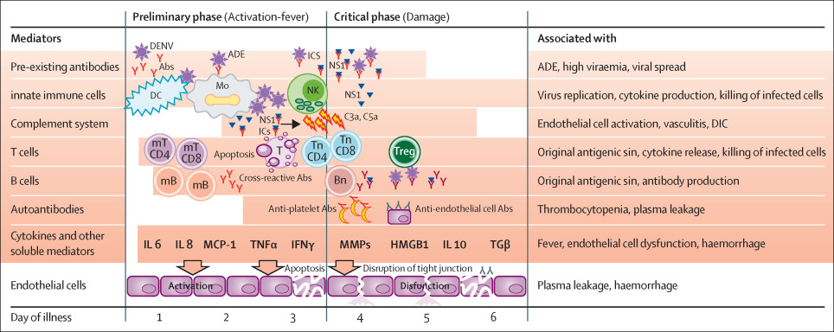
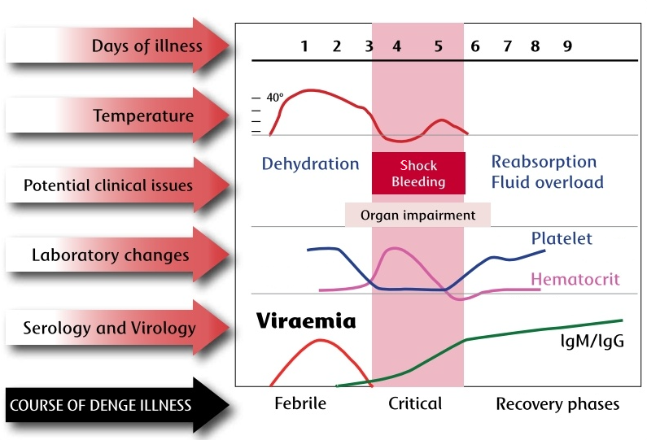
A brief overview of Dengue
Clinical case
Wide spectrum and non-specific clinical symptoms; potential confusion with other febrile illness.
Severe cases may develop bleeding and shock with potentially fatal outcomes.
Worse outcomes in children and young adults.
Lack of specific antiviral treatment or effective vaccines; management focuses on supportive care.
G. Guzman and E. Harris – Dengue – The Lancet (2014)
Figure 1. The course of dengue illness diagram. The figure, which has been adapted from WCL Yip, et all 1980 [28], presents phases, lab results, and associated problems.

Slide 5
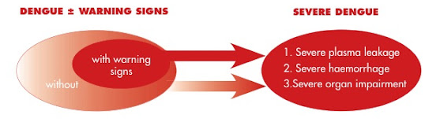
A brief overview of Dengue
Probable dengue
Live in/travel to endemic area
Fever and 2 of:
- Nausea and/or vomiting
- Rash
- Aches and pains
- Tourniquet test positive
- Leucopenia
- Any warning sign
Warning signs
- Abdominal pain or tenderness
- Persistent vomiting
- Fluid accumulation
- Mucosal bleeding
- Lethargy, restlessness
- Liver enlargement > 2cm
- Haematocrit ↑ & Platelets ↓
Severe dengue
Severe plasma leakage…
- leading to shock (DSS)
- fluid accumulation + distress
Severe bleeding
Severe organ involvement
- Liver: AST or ALT >= 100
- Impaired consciousness (CNS)
- Heart and other organs
World Health Organization – Dengue: guidelines for diagnosis, treatment, prevention and control. – WHO Bulletin (2009)

Slide 6

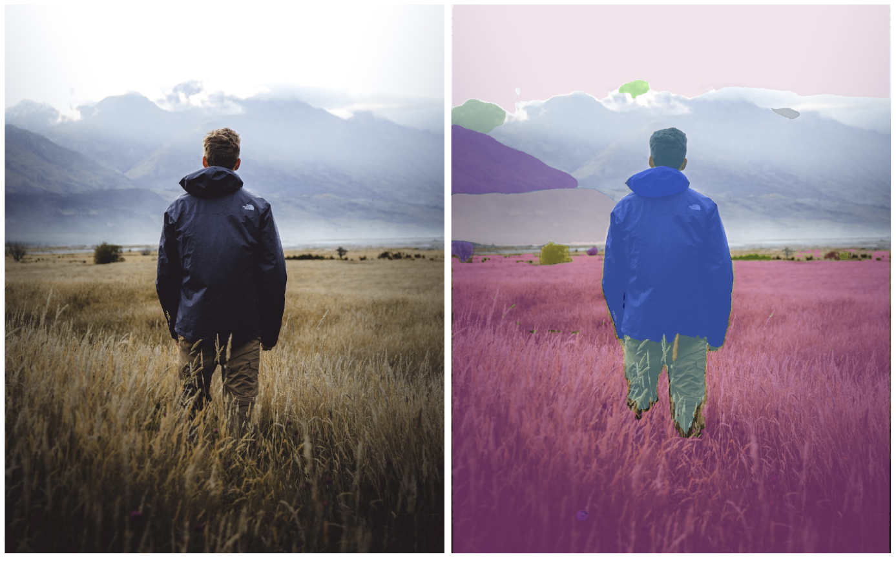
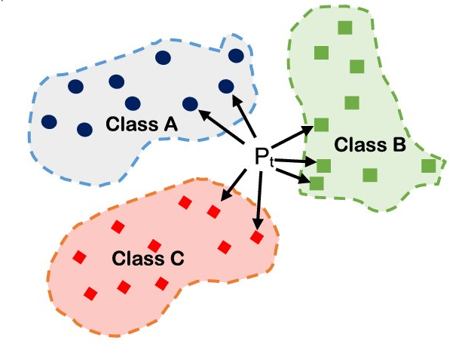
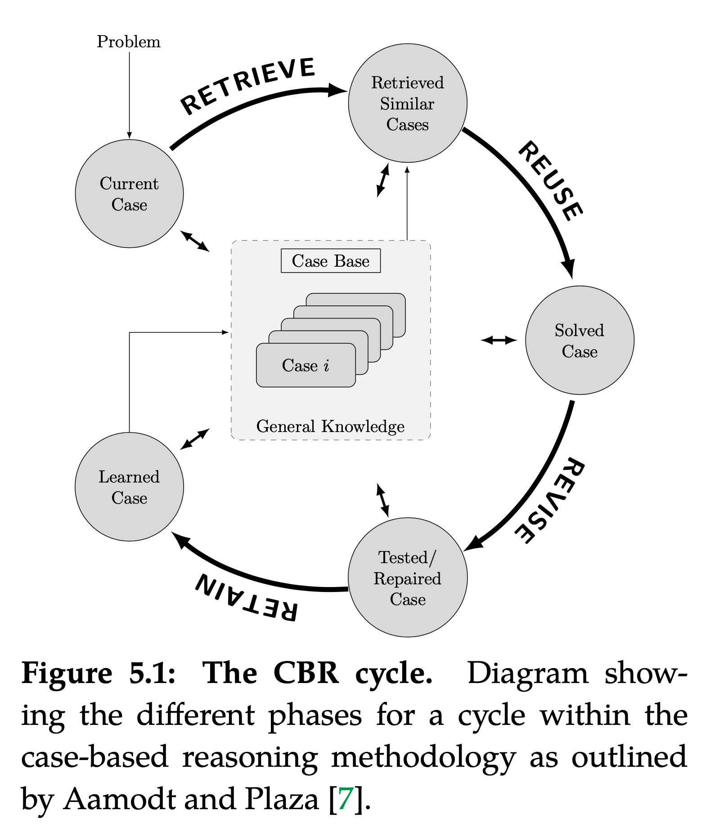
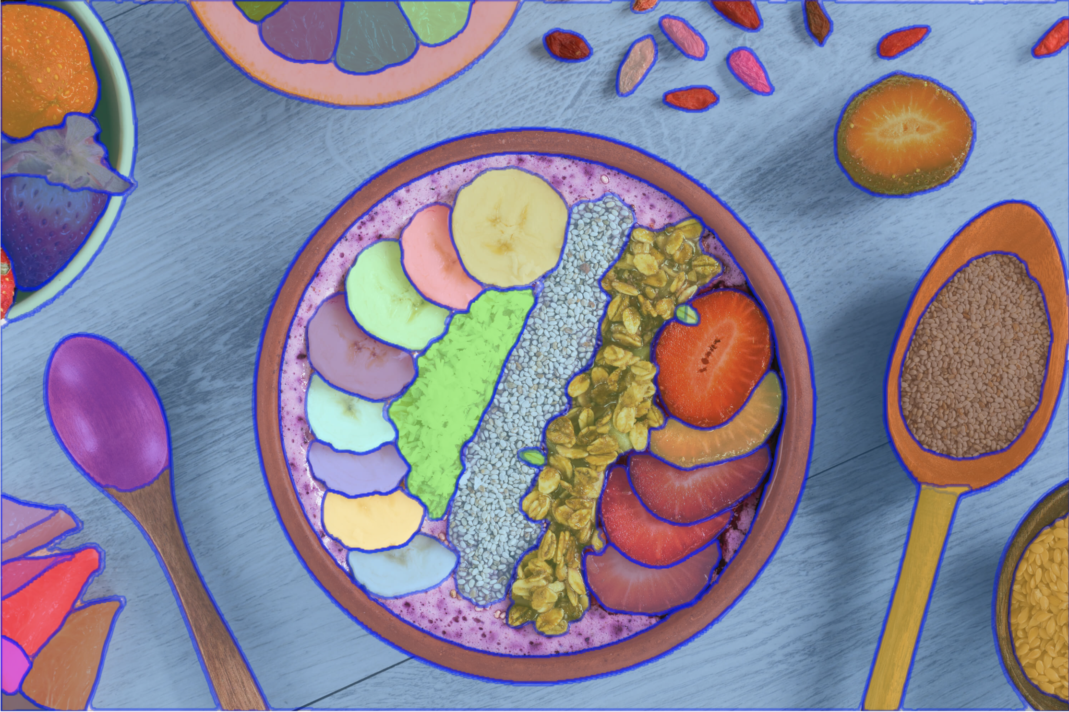
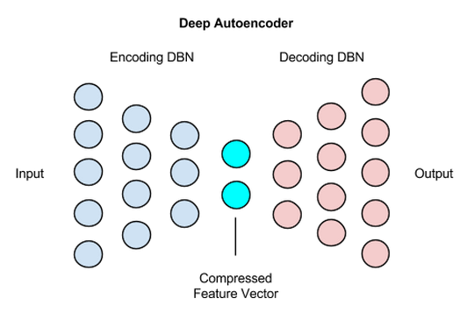
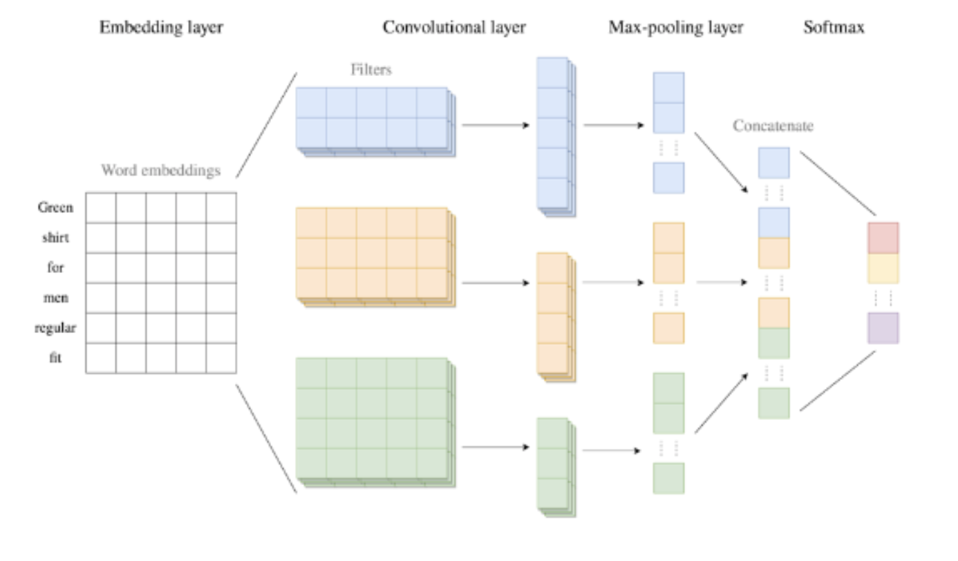
Introduction to Case-Based Reasoning
In clinical environments, physician reasoning is based on knowledge acquired from past cases personally experienced which is exactly what CBR does! The aim of CBR is to solve new problems based on the solutions of similar past problems in the form of cases
K-Nearest Neighbours (KNN)
1. TM Rawson et al – A real-world evaluation of a CBR to support antimicrobial prescribing decisions in acute care - CID (2020)
2. B Hernandez et al – Data-driven web-based intelligent CDSS: CBR benefits and limitations – Health informatics (2017)
Notes:
In clinical environments, physician reasoning is based on knowledge acquired from past cases personally experienced which is exactly what CBR does!
​
The aim of CBR is to solve new problems based on the solutions of similar past problems in form of cases. CBR is considered a methodology to follow rather than an algorithm in itself. Initially, the CBR methodology requires a set of cases or training examples denoted as case-base. Then, for a specific query, the CBR cycle is divided into four different phases.
​
Retrieve: Given a query patient, this phase retrieves from the database those cases that are relevant, based on any predefined similarity metric.
Reuse: propose a suitable solution for the query patient by adapting and/or combining the solution of the retrieved cases.
Revise: experts monitor the evolution of the patient to assess whether or not the adapted/proposed solution was appropriate.
Retain: determine whether or not the patient is of utility to be added into the case-base for future queries.
Heterogeneity often appears in healthcare data because patients' populations, environment, procedures, and treatment protocols in medical centres vary. In addition, this data is usually of high complexity and its revision in standard format (e.g forms) is very time consuming. Thus intelligent and intuitive visualisation approaches and performance optimisation for patient similarity retrieval are key! In this section we introduce the similarity retrieval module which allows to identify clinically meaningful projections of such high dimensional data in two dimensions (often called latent space) that (i) align with the established clinical characteristics of a particular disease and its progression and (ii) maps patients with similar manifestations/phenotypes close together in the latent space.
Description graph bottom right
----------------------------------------
The next layer is the convolutional layer. The convolutional layer takes the texts transformed to sequences of word embeddings as input, and creates feature vectors by analysing the word embeddings for each text. This is done by the use of convolution filters. A convolution filter is a matrix that is filled with weights, that analyses multiple consecutive words in a text simultaneously, and continues like this by going through the whole text to create a feature map. This operation is performed for every text, by using multiple convolution filters, to detect various different relationships between the words. The various convolution filters may also differ from each other in height, which indicates how many consecutive words a filter considers simultaneously in each step. To obtain the feature vectors, the feature maps following from the convolution operation all get added a bias term, and an activation function is applied to add non-linearity (ReLU is the most commonly used activation function). This non-linearity enables to learn more complex relationships.
The pooling layer takes the variable-length feature vectors of the convolutional layer as input, and creates fixed-length vectors out of them. By creating these fixed-length feature vectors, the less-relevant local information is removed.
The final layer of the CNN is the softmax layer. This layer takes the fixed-length feature vectors as input, where these vectors first enter a fully-connected layer. This fully-connected layer is an efficient way of learning non-linear combinations of the features. The output of this fully-connected layer are numerical values for each class. To assign a straightforward interpretation to these numbers, the softmax function is applied. The softmax function forces the output of the CNN to represent predicted probabilities for each of the classes. The class achieving the highest predicted probability is the resulting predicted class following from the CNN.
See: https://machine-learning-company.nl/en/technical/convolutional-neural-network-text-classification-with-risk-assessment-eng/

Slide 7
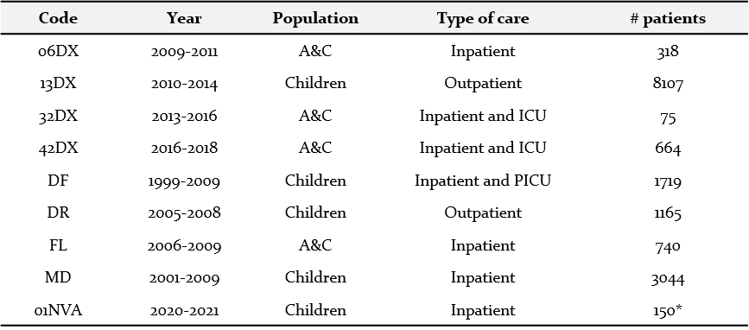
Problem definition
The dataset used in the study consists of an aggregation of prospective clinical data conducted at the Hospital of Tropical Diseases (HTD) and collaborator hospitals in Ho Chi Minh City, Vietnam by Oxford University Clinical Research Unit (OUCRU) between 2000 and 2021.
12,884
patients¹
Dataset
19,516
complete daily profiles
Demographics
4,344 (33.7%)
diagnosed with dengue²
9
datasets
Gold standard
20
years
¹ Only children (under 18 years old) have been considered since they were the most represented in the datasets and there are separate paediatric and adult dengue guidelines.
² Dengue diagnosis was defined as one of i) a positive NS1 point of care assay or NS1 ELISA, ii) positive reverse transcriptase-polymerase chain reaction (RT-PCR), iii) positive dengue IgM through acute serology, iv) or seroconversion of paired IgM samples where available.
Aim
Vital-oucru-clinical documentation (https://bahp.github.io/vital-oucru-clinical/)

Slide 8
Problem definition
Variable | Value | Overall | A (Severe) | B (Warning) | C (Probable)
n |  | 12884 | 4866 | 6809 | 4486
Age, year |  | 8 [5, 11] | 10 [8,13] | 8 [5, 11] | 6 [3, 9]
Gender | Female | 5681 (44.1%) | 2180 (44.8%) | 3073 (45.1%) | 1915 (42.7%)
Weight, Kg |  | 25 [18, 35] | 20 [24, 40] | 26 [19, 36] | 21 [15, 31]
Platelet, k/μL |  | 184 [81, 250] | 68 [36, 143] | 139 [52, 232] | 225 [177, 277]
Haematocrit, % |  | 39.8 [36.9, 44] | 45 [41, 49] | 41 [37.7, 46.2] | 37.6 [35.4, 39.9]
Body Temperature, °C |  | 37.5 [37.2, 38] | 37 [37, 38.4] | 37.5 [37.0, 38.0] | 37.4 [37.2, 37.8]
Mucosal bleeding | True | 656 (6.7%) | 487 (27.7%) | 656 (14%) | -
Vomiting | True | 5384 (50.2%) | 2499 (90.8%) | 5384 (86.9%) | -
Abdominal pain | True | 3048 (28.2%) | 1686 (60.1%) | 3048 (53.3%) | -
Abdominal tenderness | True | 1587 (12.6%) | 1459 (31.5%) | 1442 (22%) | -
Shock | True | 1960 (15.2%) | 1960 (40.4%) | 1700 (25%) | -
Vascular leakage | True | 635 (4.9%) | 635 (13%) | 587 (8.6%) | -
Significant bleeding | True | 128 (1%) | 128 (2.6%) | 118 (1.7%) | -
Organ impairment | True | 4709 (36.5%) | 4709 (96.8%) | 3156 (46.4%) | -
PCR Dengue serotype | DENV-1 | 1957 (18.1%) | 1131 (39.3%) | 1305 (22.9%) | 373 (8.4%)
 | DENV-2 | 1066 (9.9%) | 643 (22.3%) | 725 (12.7%) | 206 (4.6%)
 | DENV-3 | 321 (3%) | 125 (4.3%) | 187 (12.7%) | 99 (2.2%)
 | DENV-4 | 706 (6.5%) | 173 (6%) | 381 (6.7%) | 297 (6.7%)
 | Mixed | 18 (0.1%) | 18 (0.7%) | 12 (0.2%) | -
Dataset
Demographics
Gold standard
Aim
B. Hernandez et al – Learning meaningful latent space representations for patient risk stratification: Dengue and other acute febrile illness – Frontier Digital Health (2023)
Notes:
Category A: Any vascular leakage, significant bleeding, organ impairment and/or shock.
Category B: Abdominal pain/tenderness, persistent vomiting, ascites, pleural effusion, bleeding mucosal, lethargy, restlessness and/or liver enlargement over 2cm.
Category B: No complications or warning signs.

Slide 9
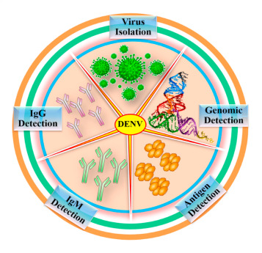
Problem definition
Diagnosis
Polymerase Chain Reaction (PCR)
NS1 Antigen Test
igM positive through acute serology
Seroconversion (ether single or paired igM and igG)
Classification
WHO 2009
Probable Dengue: Mild
Warning signs: Medium
Severe dengue: Severe
WHO 1997
Dengue Fever (DF): Standard
Dengue Haemorrhagic Fever (DHF): Medium
Dengue Shock Syndrome (DSS): Severe
Dataset
Demographics
Gold standard
Aim
S. Subraya et al– Dengue detection: Advances and challenges in diagnostic technology. – Biosensors and Bioelectronics (2022)
World Health Organization – Dengue: guidelines for diagnosis, treatment, prevention and control. – WHO Bulletin (2009)
Repository with vital-oucru-clinical documentation: https://bahp.github.io/vital-oucru-clinical/

Slide 10
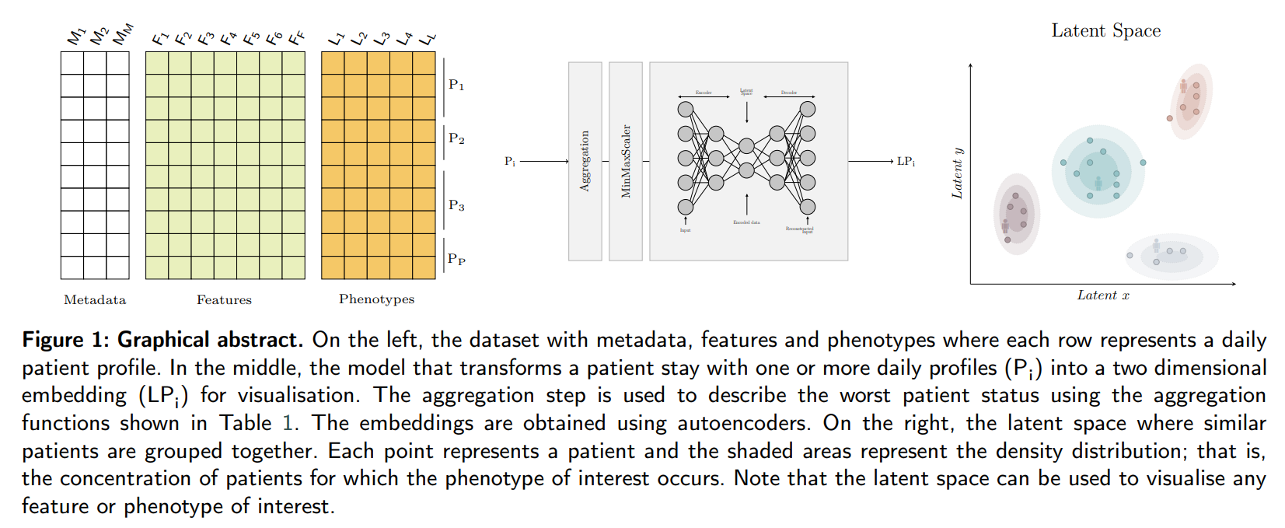
Problem definition
AIM: Development of a clinical decision support tool to support clinical management of patients with (or under suspicion of) dengue using unsupervised techniques to reduce data complexity and facilitate visualisation.
Dataset
Demographics
Gold standard
Aim
B. Hernandez et al – Learning meaningful latent space representations for patient risk stratification: Dengue and other acute febrile illness – Frontier Digital Health (2023)

Slide 11
Experimental setup
Choosing your data wisely is crucial for model performance and feasibility of both implementation and adoption.
Clinical relevance
Data availability
Quality of data
Frequency of data updates
Cost of data collection
Resource requirements
Turnaround time
Robustness to missing data
Preprocessing requirements
Clinical workflow integration
Interoperability with existing systems
Ethical and Legal considerations
Setting (e.g., LMIC, ICU, …)
Correlation between variables
Age (year)
Weight (kg)
Body Temperature (°C)
Platelets (k/μL)
Haematocrit (%)
Feature selection
Figure 1. The course of dengue illness diagram. The figure, which has been adapted from WCL Yip, et all 1980 [28], presents phases, lab results, and associated problems.
B. Hernandez et al – Learning meaningful latent space representations for patient risk stratification: Dengue and other acute febrile illness – Frontier Digital Health (2023)
Notes:
Feature selection
- Features were consistently recorded in all clinical studies.
- Provide information on the course of dengue illness (WHO).
- Feasibility of prospective collection
- It is not time series
- Seems that a clear max/min tendency is used
- Do

Slide 12
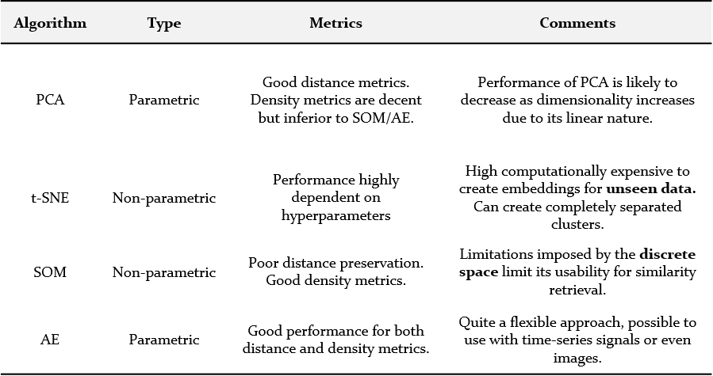
Experimental setup
Choosing the appropriate machine learning (ML) approach according to your data and objectives is crucial for performance, implementation and adoption
Labels
Problem type
Data type
Complexity
Interpretability
Resources
Scalability
Adaptation
Adoption
Feature selection
Algorithm | Type | Continuous space | Unseen data | Comments
PCA | Parametric | ✓ | ✓ | The performance is likely to decrease as dimensionality increases due to its linear nature
T-SNE | Non-parametric | ✓ |  | Its inability to be applied to unseen data points makes a real-time similarity retrieval system impossible.
UMAP | Non-parametric | ✓ |  | Performance is considerably worse than other approaches for dimensionality reduction.
SOM | Non-parametric |  | ✓ | The limitations imposed by the discrete space limits the applicability to similarity retrieval.
Autoencoder | Parametric | ✓ | ✓ | The ability to encode unseen samples and its support for higher-dimensional data, including time series and images, make it flexible and idea for similarity retrieval.
Algorithm selection
PCA: Principal Component Analysis; t-SNE: t-distributed Stochastic Neighbour Embedding;
UMAP: Uniform Manifold Approximation and Projection; SOM: Self-Organising Maps;
B. Hernandez et al – Learning meaningful latent space representations for patient risk stratification: Dengue and other acute febrile illness – Frontier Digital Health (2023)
¹ UMAP might be also a promising algorithm.
Notes:
Algorithm selection
Map to 2D…

Slide 13
Experimental setup
Autoencoder: Neural network to encode input data by copying the input to the output. Autoencoders are composed of to elements: encoder and decoder.
- Minimizes the difference between input/output.
- Encourages to learn meaningful representations.
- Extracts more important features.
- Works for different types of data.
Such as image, speech, time series, …
- Captures complex patterns (non-linear).
Feature selection
Algorithm selection
Autoencoder
B. Hernandez et al – Learning meaningful latent space representations for patient risk stratification: Dengue and other acute febrile illness – Frontier Digital Health (2023)
Notes:
Autoencoders
Map to 2D…

Slide 14
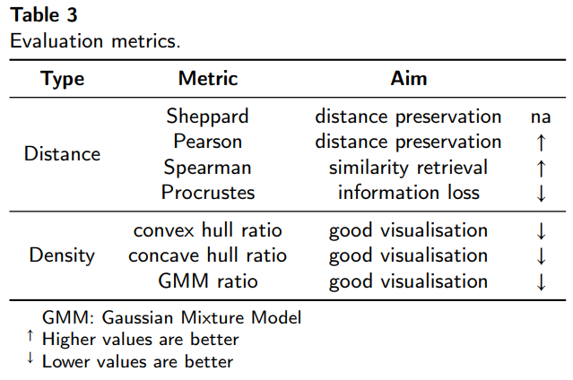
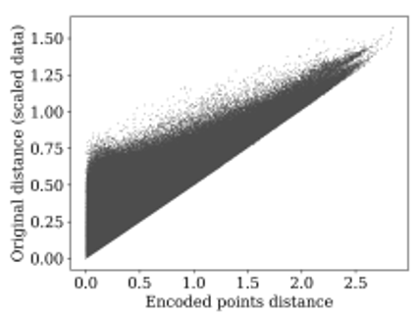
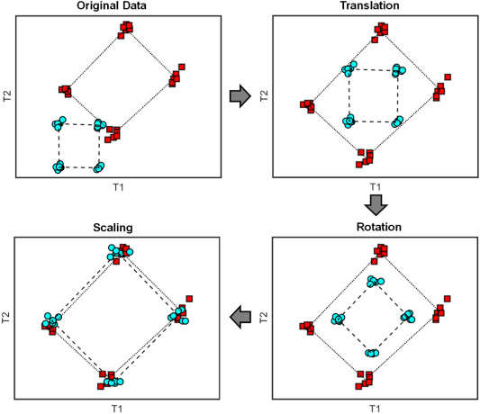
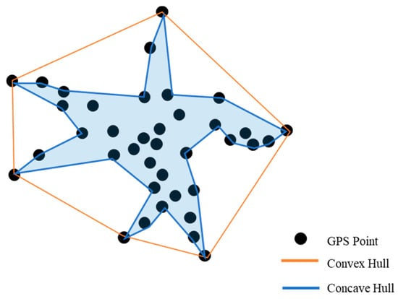
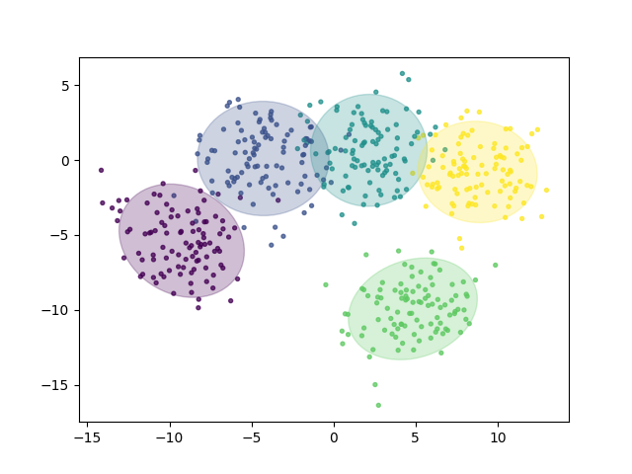
Experimental setup
Sheppard
Procrustes
Feature selection
Algorithm selection
Autoencoder
Hull ratio
Evaluation
Sheppard: Scatter plot of pairwise distances.
Pearson: Linear correlation to verify if distances are preserved.
Spearman: Dependence between rankings, for similarity retrieval.
Procrustes: Compare shape of two objects through superimposition from original to reduced spaces and measures information loss.
GMM: Overlapping area within classes. It is more robust to outliers than convex/concave hull ratio.
GMM ratio
B. Hernandez et al – Learning meaningful latent space representations for patient risk stratification: Dengue and other acute febrile illness – Frontier Digital Health (2023)
Notes:
Evaluation
Sheppard diagrams are scatter plots of two measurements of distances between objects. In dimensionality reduction analysis, the first measurement or collection of distances corresponds to the points in the original dimension. The second measurement is the distances in the reduced space. The diagram shows how well distances have been preserved relative to one another. Collinear points indicate that there has been no distortion. The more points do not lie on this line, the more the distances have been distorted and information lost whilst reducing the dimensionality.
The Pearson correlation coefficient is a statistical measure that gives the linear correlation between two variables.
Spearman rank correlation coefficient: It measures the dependence between the rankings of two variables. There are applications where maintaining the ordering of distances is more important than having a linear relationship between the distances in the original and reduced spaces. Similarity retrieval, for example, will provide the same results in the original space and the two-dimensional space if the Spearman rank correlation coefficient of the distances in both spaces is one.
The GMM ratio uses Gaussian Mixture Models with one component. The metric takes the ratio of the area of the confidence ellipsoid of a model fitted to data points with a given label to the area of the confidence ellipsoid of a model fitted to all data points.

Slide 15
Experimental setup
Cleaning
Unit alignment, spelling and typos, variable names, duplicate data, outlier removal, inconsistent values, format date and time inputs, …
Imbalance
There are 37.7% of cases diagnose with dengue.
Note we are not doing detection.
Scaling
Used standard scaling to help algorithm to converge faster.
Feature engineering
Age – First
Weight – Mean
Body Temperature – Max
Platelets – Min
Hematocrit – Max
Progression of dengue illness follows a clearly defined course.
Ability to provide support from admission.
Ability to recalculate and update on every new input.
12884 patients
19516 daily profiles
Admission on day 2-3...?
Data collection till 7-8…?
Feature selection
Algorithm selection
Autoencoder
Evaluation
Processing
Cleaning
Imbalance
Imputation
Scaling
Figure 1. The course of dengue illness diagram. The figure, which has been adapted from WCL Yip, et all 1980 [28], presents phases, lab results, and associated problems.
Feature Engineering
B. Hernandez et al – Learning meaningful latent space representations for patient risk stratification: Dengue and other acute febrile illness – Frontier Digital Health (2023)
Notes:
Imputation on the training data - None
Imputation on the trajectory…
- On admission always values collected.
- For then onwards, forward filling when new variable becomes available.

Slide 16

Experimental setup
Parameter | Comments
Layersª | [] ^{b} , [5], [4], [3], [5,4], [5,3], [4,3], [5,4,3], [4,4,3,3]
Activation | “ReLU”, “Sigmoid”
Learning rate | 0.005, 0.001, 5x10⁻⁴, 1x10⁻⁴, 5x10⁻⁵, 1x10⁻⁵
Epochs | 10, 30, 50, 100, 150, 250, 350, 500
Batch size | 16, 32
Feature selection
Algorithm selection
Autoencoder
Table 2. Grid search hyperparameters.
ª Layers refers to the hidden layers used in the encoder. The input layer and latent layer are not included. The decoder layers are the mirror image of the encoder layers.
^{b} No hidden layers other than the latent dimension.
Evaluation
Processing
Cleaning
Imbalance
Imputation
Scaling
Feature Engineering
Hyperparameters
B. Hernandez et al – Learning meaningful latent space representations for patient risk stratification: Dengue and other acute febrile illness – Frontier Digital Health (2023)

Slide 17
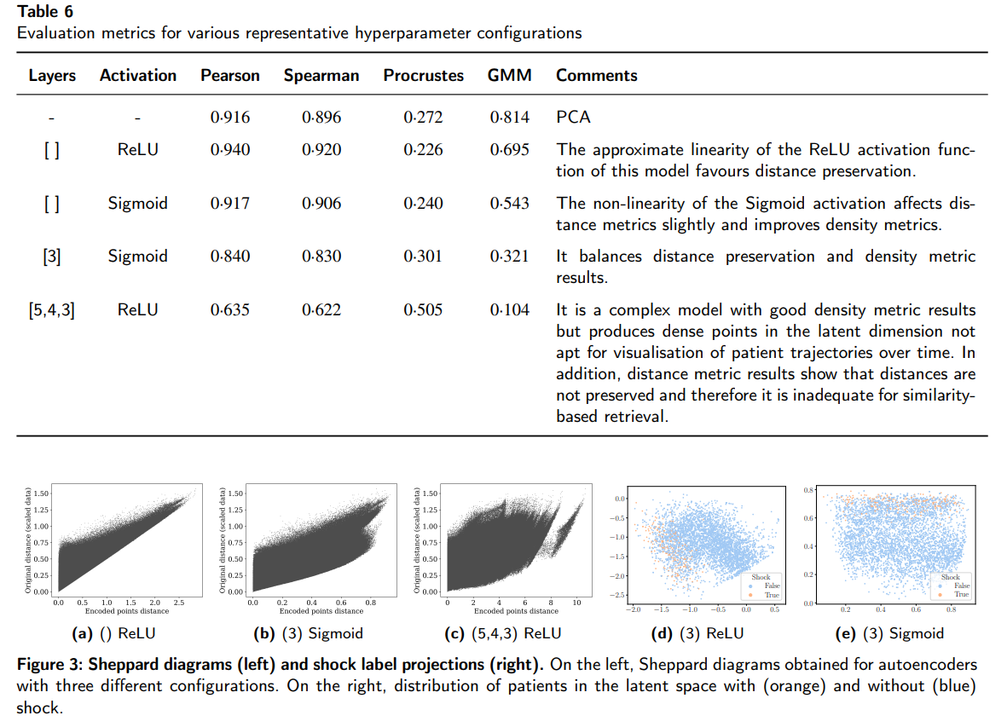
Assessment and evaluation
↑
↑
↓
↓
Performance
B. Hernandez et al – Learning meaningful latent space representations for patient risk stratification: Dengue and other acute febrile illness – Frontier Digital Health (2023)

Slide 18
Assessment and evaluation
Performance
Clustering
O. Stiff– Patient similarity retrieval based on laboratory data cluster analysis and visualization – M.Sc. thesis (2022)

Slide 19













Assessment and evaluation
Latent space
Query patient
Male / phenotype A
Phenotype B
Performance
Female / no phenotype A
Phenotype C
Obesity
Phenotype B & C
Clustering
Older patient
Hexagonal bin
Further analysis
Feature (e.g. Age)
= mean (12*3 + 11*2 + 9*4 + 3*1) = 9.7
Phenotype (e.g. Shock) *
≈ 7 / (7 + 3) = 0.7 = 70%
Category (e.g. Female & Phenotype) *
≈ 2 / (2 + 8) = 0.8 = 80%
* It is actually the density distribution using Gaussian Kernel
B. Hernandez et al – Learning meaningful latent space representations for patient risk stratification: Dengue and other acute febrile illness – Frontier Digital Health (2023)
Notes:
It does not exactly work like that, because if we do it that way, it would be affected by the prevalence.
What it does is to calculate the density if patients in that cell in comparison to other cells thus only positives are counted.
It can be done for any feature, phenotype, category, or even if labels change for some reason.

Slide 20
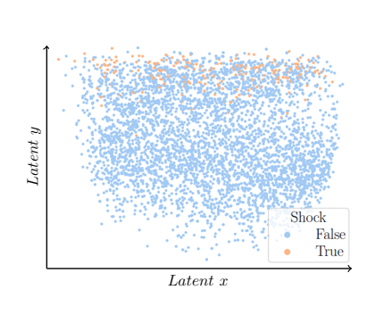
Assessment and evaluation
Each point on the graph represents a complete patient’s hospital stay, with those experiencing shock displayed in orange. They all seem to be grouped on the top area.
Performance
Clustering
Higher risk
Further analysis
Lower risk
Latent space
Figure 2. Latent space: embeddings. The worst patient status for all the patients has been projected into the latent space with the shock phenotype.
B. Hernandez et al – Learning meaningful latent space representations for patient risk stratification: Dengue and other acute febrile illness – Frontier Digital Health (2023)

Slide 21
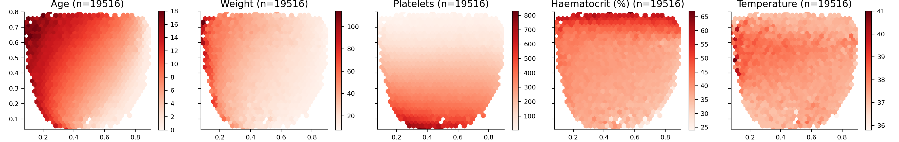
Assessment and evaluation
Aligns with established characteristics of disease progression such as increase in haematocrit levels ↑, decrease in platelet levels ↓ and decrease in body temperature from febrile to critical phase.
Performance
Clustering
Further analysis
Latent space
Features
Figure 1. The course of dengue illness diagram. The figure, which has been adapted from WCL Yip, et all 1980 [28], presents phases, lab results, and associated problems.
Figure 3. Latent space description: Features. The graphs represent the density distribution using hexagonal binning over the latent space.
B. Hernandez et al – Learning meaningful latent space representations for patient risk stratification: Dengue and other acute febrile illness – Frontier Digital Health (2023)

Slide 22
Assessment and evaluation
Aligns with established characteristics of disease progression such as increase in haematocrit levels ↑, decrease in platelet levels ↓ and decrease in body temperature from febrile to critical phase.
Performance
Clustering
Further analysis
Latent space
Features
Figure 1. The course of dengue illness diagram. The figure, which has been adapted from WCL Yip, et all 1980 [28], presents phases, lab results, and associated problems.
Figure 3. Latent space description: Features. The graphs represent the density distribution using hexagonal binning over the latent space.
B. Hernandez et al – Learning meaningful latent space representations for patient risk stratification: Dengue and other acute febrile illness – Frontier Digital Health (2023)

Slide 23
Assessment and evaluation
Aligns with established characteristics of disease progression such as increase in haematocrit levels ↑, decrease in platelet levels ↓ and decrease in body temperature from febrile to critical phase.
Performance
Clustering
Further analysis
Latent space
Features
Figure 1. The course of dengue illness diagram. The figure, which has been adapted from WCL Yip, et all 1980 [28], presents phases, lab results, and associated problems.
Figure 3. Latent space description: Features. The graphs represent the density distribution using hexagonal binning over the latent space.
B. Hernandez et al – Learning meaningful latent space representations for patient risk stratification: Dengue and other acute febrile illness – Frontier Digital Health (2023)

Slide 24
Assessment and evaluation
Aligns with established characteristics of disease progression such as increase in haematocrit levels ↑, decrease in platelet levels ↓ and decrease in body temperature from febrile to critical phase.
Performance
Clustering
Further analysis
Latent space
Features
Figure 1. The course of dengue illness diagram. The figure, which has been adapted from WCL Yip, et all 1980 [28], presents phases, lab results, and associated problems.
Figure 3. Latent space description: Features. The graphs represent the density distribution using hexagonal binning over the latent space.
B. Hernandez et al – Learning meaningful latent space representations for patient risk stratification: Dengue and other acute febrile illness – Frontier Digital Health (2023)

Slide 25
Assessment and evaluation
Aligns with established characteristics of disease progression such as increase in haematocrit levels ↑, decrease in platelet levels ↓ and decrease in body temperature from febrile to critical phase.
Performance
Clustering
Further analysis
Latent space
Features
Figure 1. The course of dengue illness diagram. The figure, which has been adapted from WCL Yip, et all 1980 [28], presents phases, lab results, and associated problems.
Figure 3. Latent space description: Features. The graphs represent the density distribution using hexagonal binning over the latent space.
B. Hernandez et al – Learning meaningful latent space representations for patient risk stratification: Dengue and other acute febrile illness – Frontier Digital Health (2023)

Slide 26
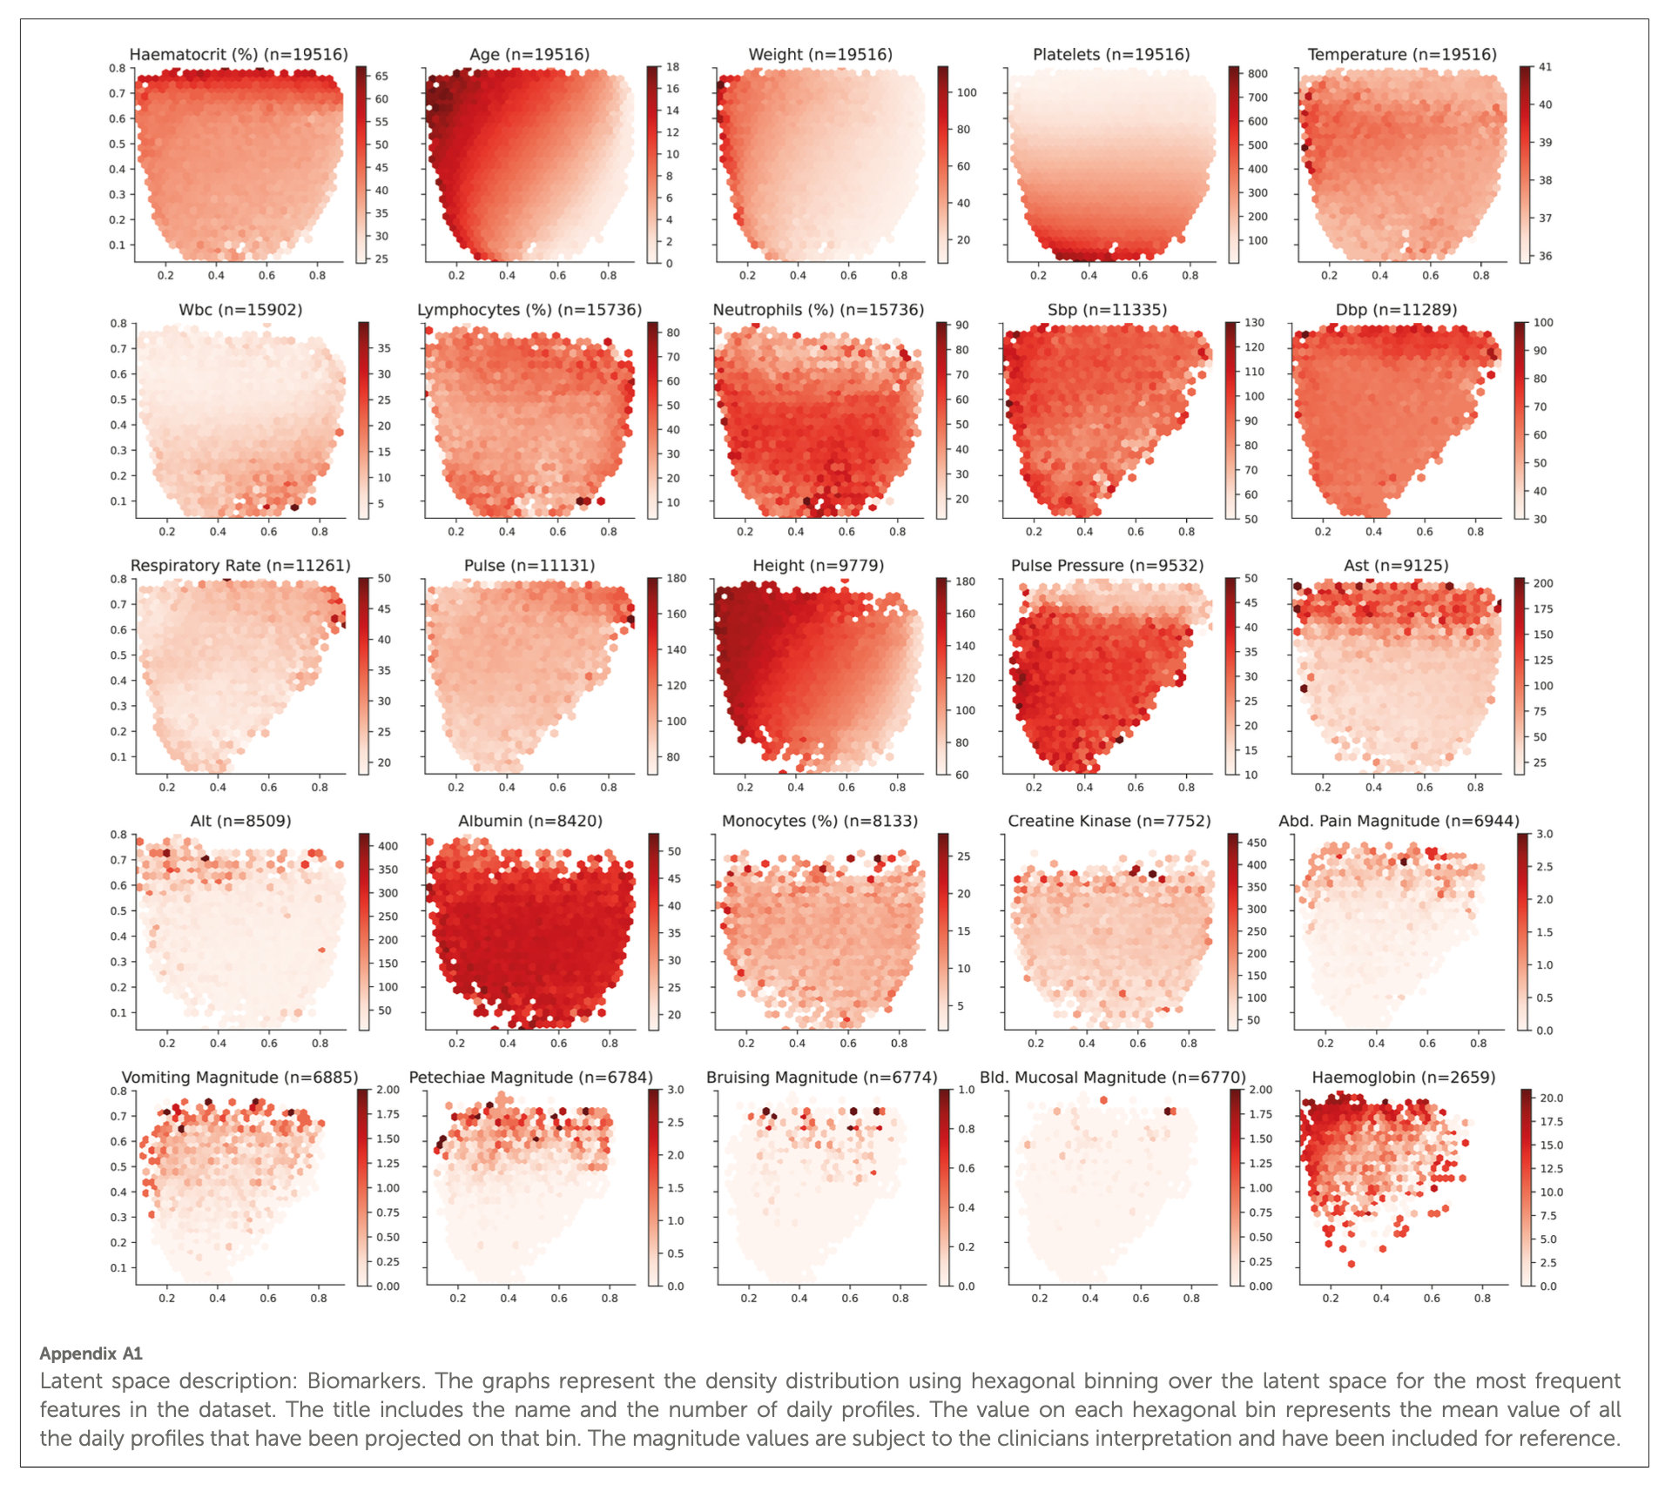
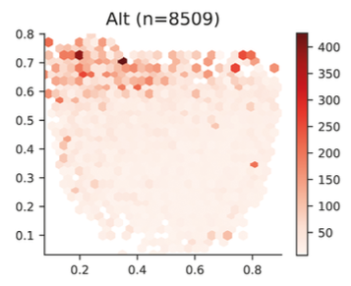
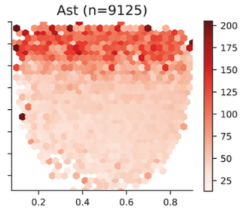
Assessment and evaluation
Performance
Clustering
Further analysis
Latent space
Features
B. Hernandez et al – Learning meaningful latent space representations for patient risk stratification: Dengue and other acute febrile illness – Frontier Digital Health (2023)

Slide 27
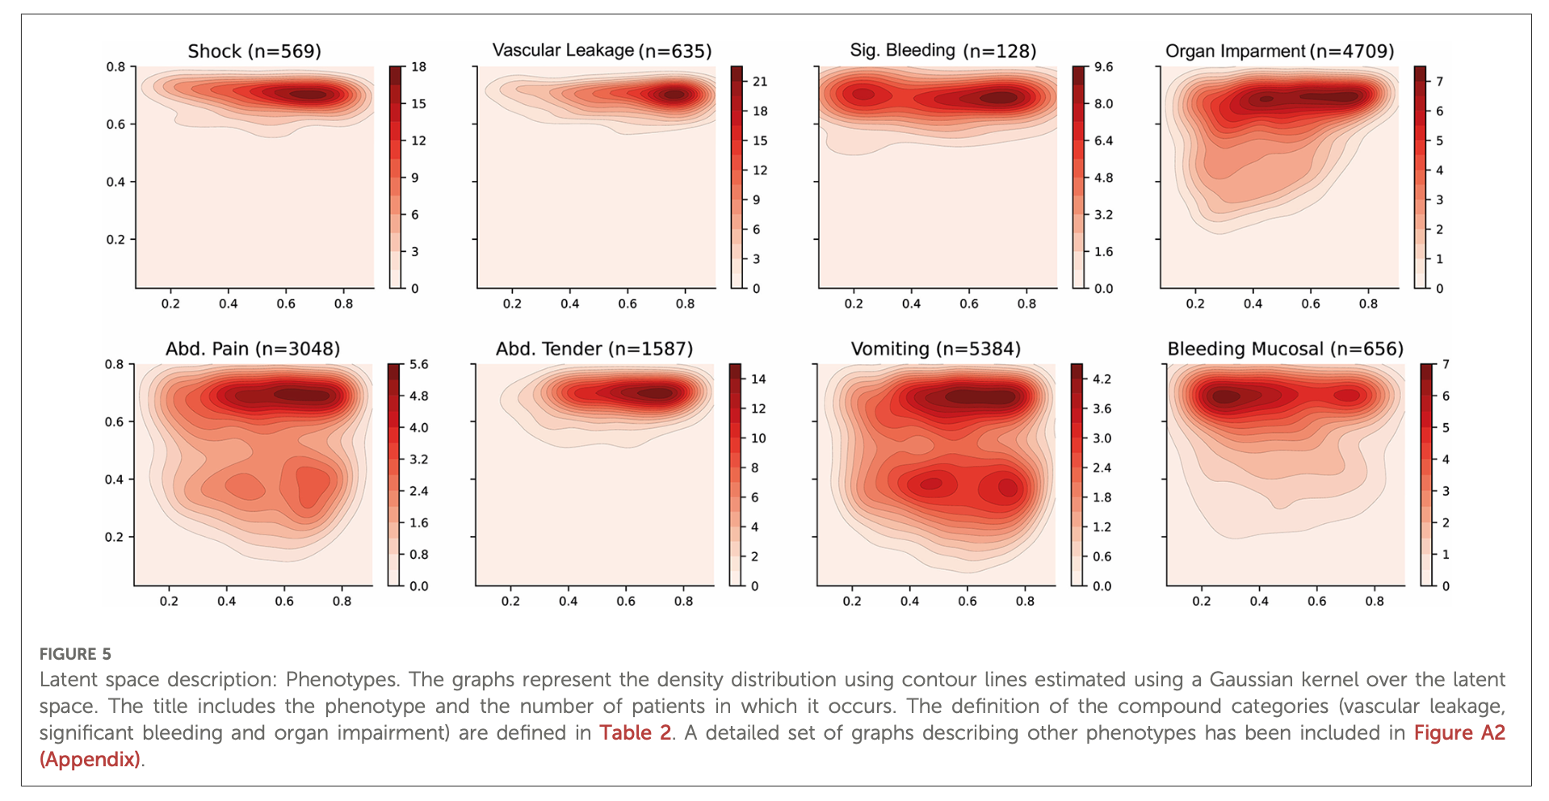
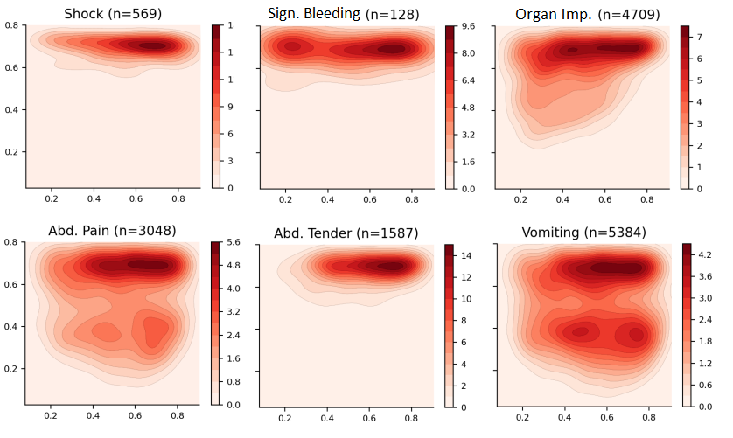
Assessment and evaluation
Performance
Clustering
Further analysis
Latent space
Features
Phenotypes
Figure 4. Latent space description: Phenotypes. The graphs represent the density distribution of patients’ projections in the latent space for those suffering the specified phenotype using contour lines using a Gaussian kernel.
World Health Organization – Dengue: guidelines for diagnosis, treatment, prevention and control. – WHO Bulletin (2009)
B. Hernandez et al – Learning meaningful latent space representations for patient risk stratification: Dengue and other acute febrile illness – Frontier Digital Health (2023)

Slide 28
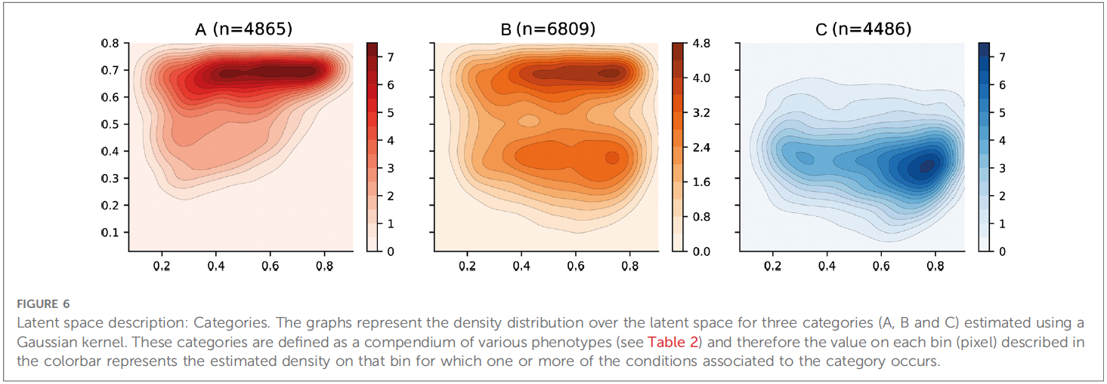
Assessment and evaluation
Severe dengue
Severe plasma leakage…
- leading to shock (DSS)
- fluid accumulation + distress
Severe bleeding
Severe organ involvement
- Liver: AST or ALT >= 100
- Impaired consciousness (CNS)
- Heart and other organs
Warning signs
- Abdominal pain or tenderness
- Persistent vomiting
- Fluid accumulation
- Mucosal bleeding
- Lethargy, restlessness
- Liver enlargement > 2cm
- Haematocrit ↑ & Platelets ↓
Probable dengue
Live in/travel to endemic area
Fever and 2 of:
- Nausea and/or vomiting
- Rash
- Aches and pains
- Tourniquet test positive
- Leucopenia
- Any warning sign
Performance
Clustering
Further analysis
Latent space
Features
Phenotypes
Categories
World Health Organization – Dengue: guidelines for diagnosis, treatment, prevention and control. – WHO Bulletin (2009)
B. Hernandez et al – Learning meaningful latent space representations for patient risk stratification: Dengue and other acute febrile illness – Frontier Digital Health (2023)

Slide 29
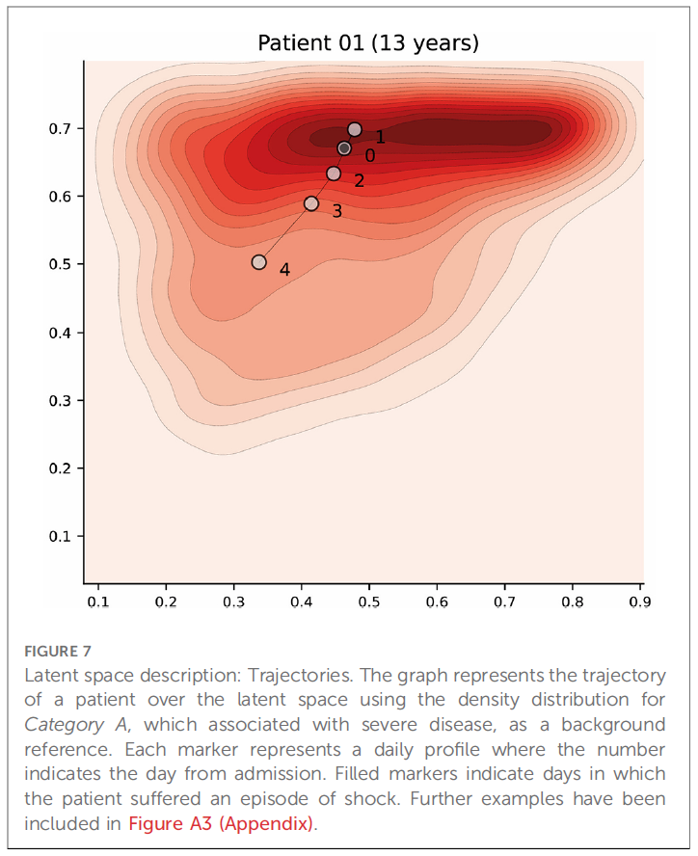
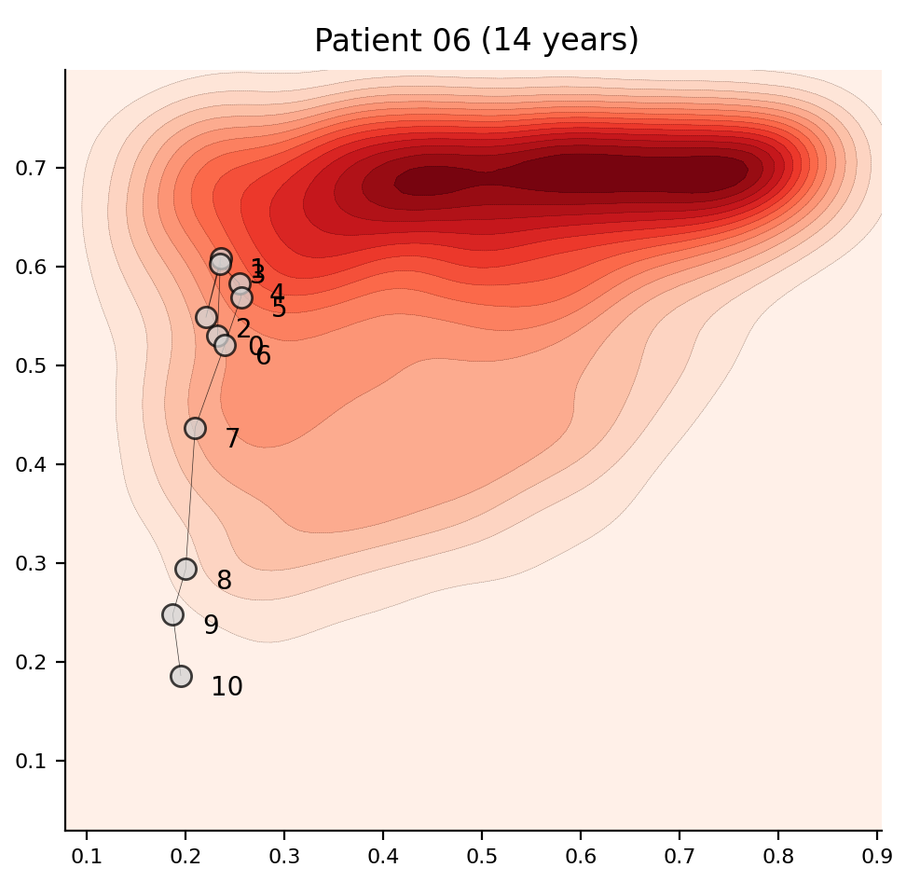
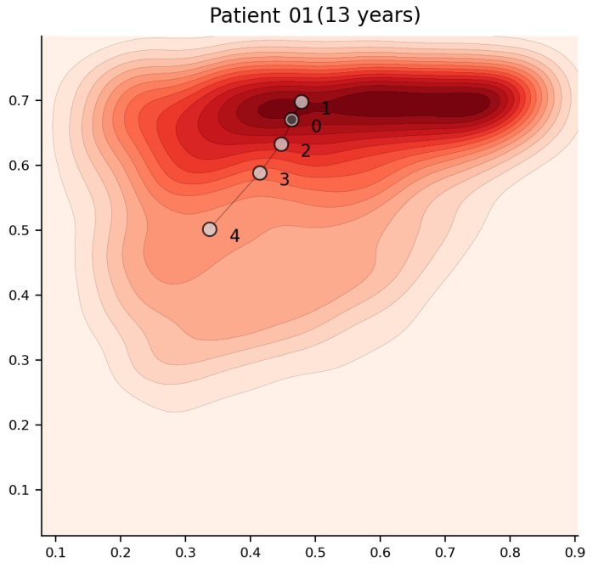
Assessment and evaluation
Performance
Clustering
Further analysis
Latent space
Features
Phenotypes
Categories
Trajectories
Figure 7. Latent space description: Trajectories. The graphs represent the trajectory of a two different patients over the Category A which aligns with the severe definition. The number represents the day from admission. Filled nodes indicate that the patient had shock on that day.
B. Hernandez et al – Learning meaningful latent space representations for patient risk stratification: Dengue and other acute febrile illness – Frontier Digital Health (2023)

Slide 30
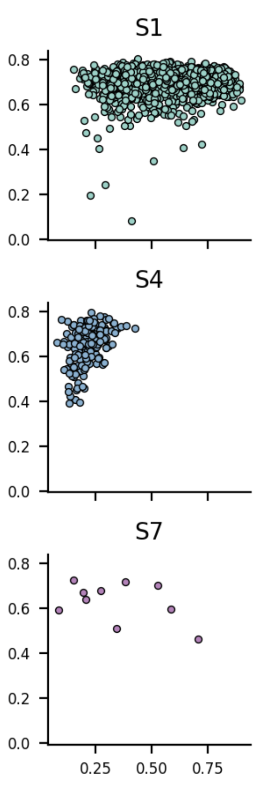
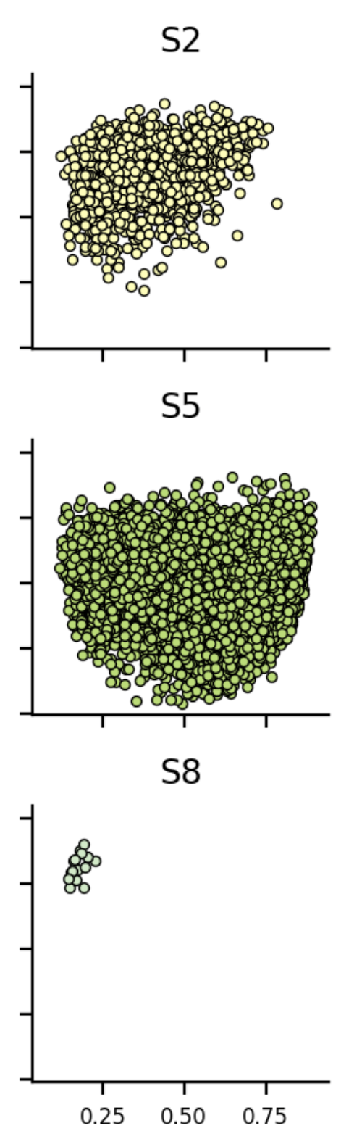
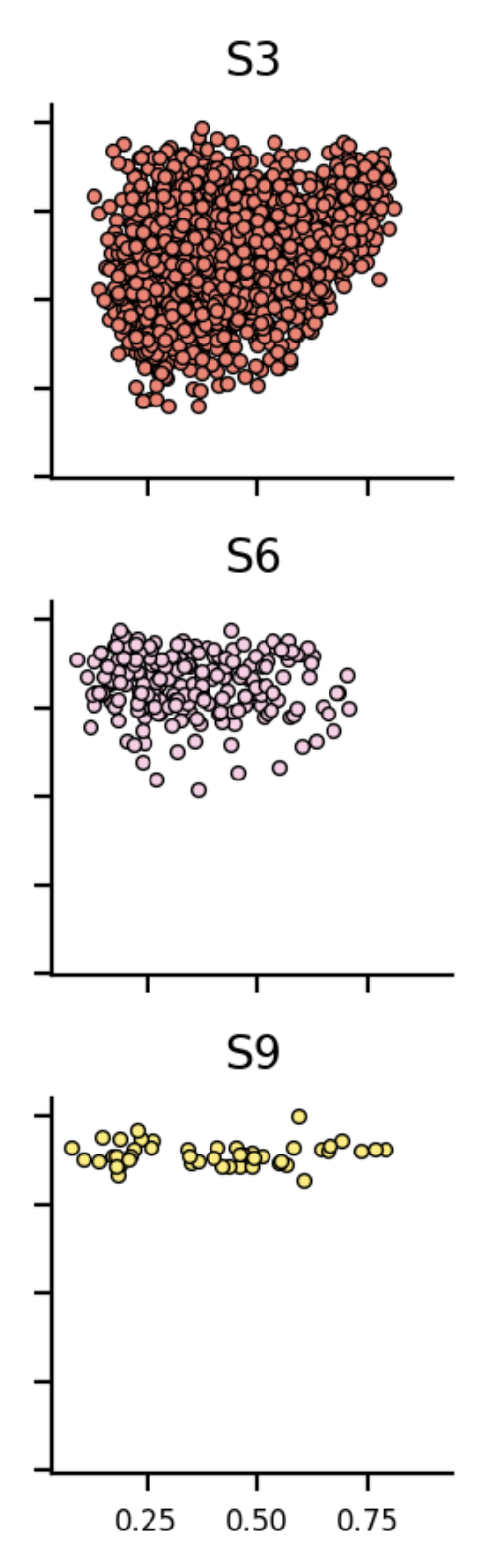
Assessment and evaluation
Description of studies
S1: Inpatient-based prospective observational descriptive study of clinical features of DSS in children and comparison of different fluid solutions for initial resuscitation.
S2: Inpatient-based prospective observational descriptive study examining prognostic factors during the febrile phase of non-severe dengue in children.
S4: A pilot study to investigate the effects of short course oral corticosteroid therapy in early dengue infection in Vietnamese patients.
S6: Laboratory diagnosis and prognosis of severe dengue.
S8: A matched cohort study to characterise the clinical manifestations of dengue in pregnancy and investigate the spectrum of adverse maternal and foetal outcomes.
S9: Innovative biomedical engineering and computational science to improve the management of critical illness in resource- limited settings.
Performance
Clustering
Further analysis
Latent space
Features
Phenotypes
Categories
Trajectories
Similarity retrieval
B. Hernandez et al – Learning meaningful latent space representations for patient risk stratification: Dengue and other acute febrile illness – Frontier Digital Health (2023)

Slide 31
Assessment and evaluation
Latent space
Query patient
Male / phenotype A
Phenotype B
Performance
Female / no phenotype A
Phenotype C
Obesity
Phenotype B & C
Clustering
Older patient
Search area
Further analysis
Age
Latent space
Weight
Features
Haematocrit
Phenotypes
Platelets
Categories
Body temperature
Trajectories
Phenotype A
Similarity retrieval
Phenotype B
Phenotype C
For any feature, phenotype or category.
If value not available, it will just not be counted.
B. Hernandez et al – Learning meaningful latent space representations for patient risk stratification: Dengue and other acute febrile illness – Frontier Digital Health (2023)
Notes:
It does not exactly work like that, because if we do it that way, it would be affected by the prevalence.
What it does is to calculate the density if patients in that cell in comparison to other cells thus only positives are counted.
It can be done for any feature, phenotype, category, or even if labels change for some reason.

Slide 32
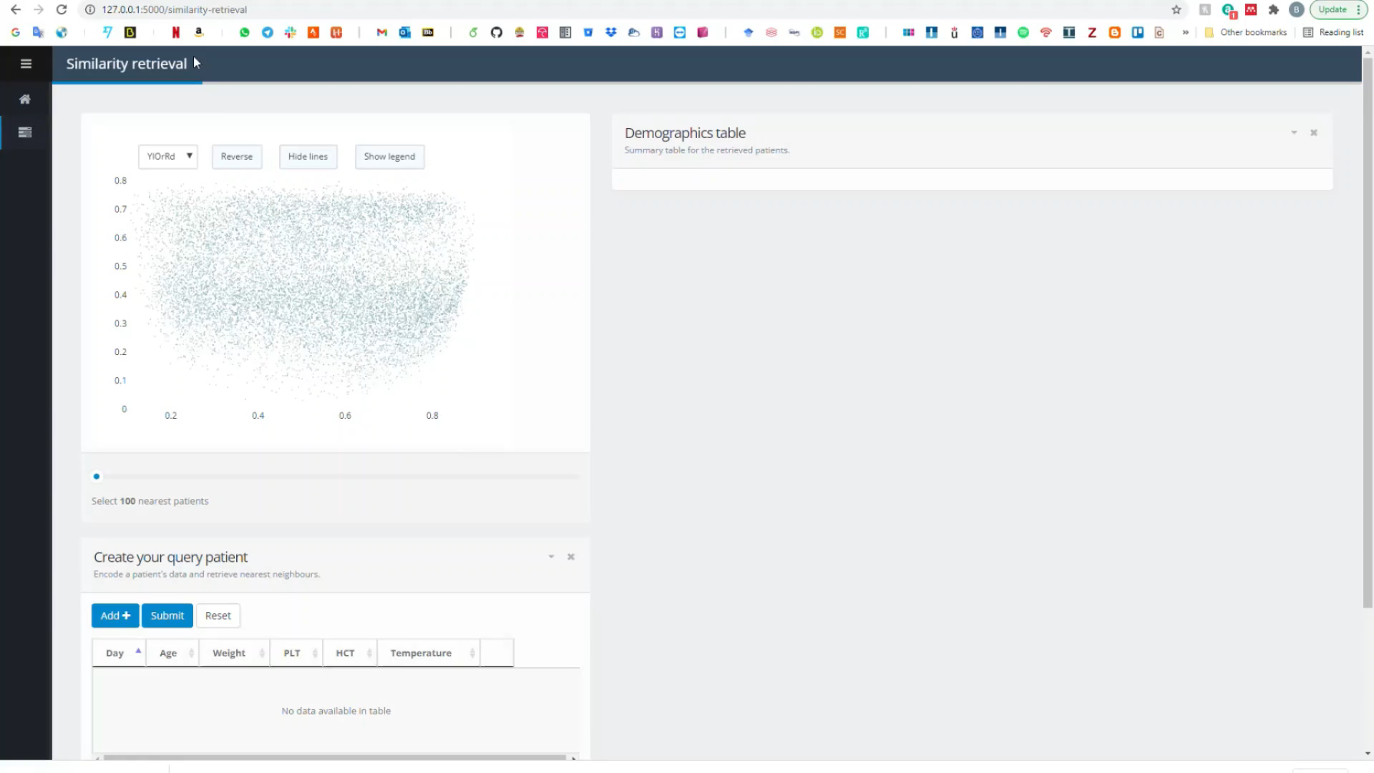
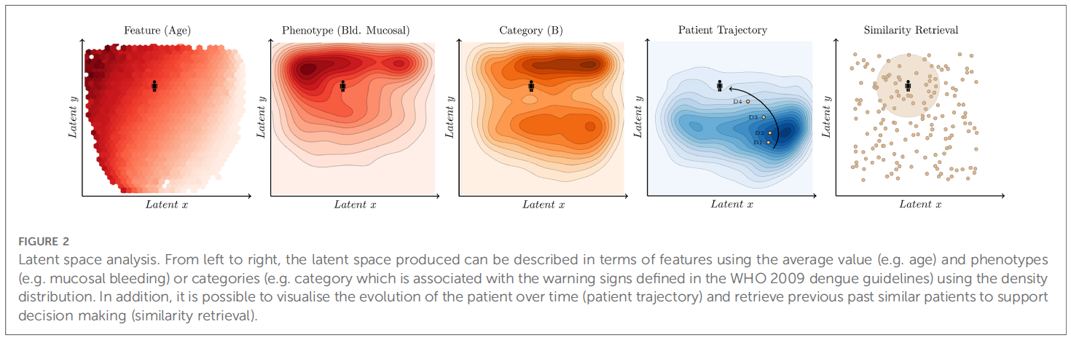
CDSS prototype for Dengue
B Hernandez et al – Learning meaningful latent space representations for patient risk stratification: Dengue and other acute febrile illness – Frontier Digital Health (2023)
Notes:
A novel case-based approach, leveraging the power of autoencoders to reduce the input features of dengue patients into a two-dimensional (2D) space for enhanced visualization has been prototype. Dengue, with its well-known disease dynamics encompassing the febrile, critical, and recovery phases, serves as an ideal candidate for this approach. By employing autoencoders, which are neural networks designed to compress and reconstruct data, the vast array of patient features can be effectively condensed into a concise 2D representation. This reduction not only facilitates the efficient retrieval of similar patients but also enables the visualization of patient clusters using density maps, highlighting various phenotypes and categories based on the extracted features. Moreover, this approach allows for the visualization of a patient's evolution over time, providing valuable insights into the progression of the disease. By combining the power of autoencoders and the dynamics of a disease, this case-based approach offers a promising avenue for improved patient characterization and understanding of the disease's intricate patterns.

Slide 33
QUESTIONS
?
Bernard Hernandez
b.hernandez-perez@imperial.ac.uk
Department of Medicine
Imperial College London
https://bahp.github.io/portfolio-academic/
14th of December 2023
Notes:
Problem definition
Dataset
Demographics
Gold standard
Aim
Feature selection
Data collection
Relevance
Temporal availability
Quantity
Leakage (target/time)
Model selection
Unsupervised
Complexity
Interpretability
Adoption/Adaptation
Experimental setup
Discard
Outliers
Imbalance
Imputation
Scaling
Feature engineering
Tuning
Further analysis
Deployment
Legal
Resources
Communication/Transparency
Deployment
Continuous monitoring/updatees

Slide 34












AREAS OF RESEARCH FOR CDSS
Areas of research to leverage healthcare through clinical decision support systems
Management to facilitate access to records, laboratory results, and communication.
Facilitate data collection to enhance decisions, send reminders or clinical alerts
Patient engagement to improve understanding and shape future patient behaviour
Assess or predict complications using machine learning methods on tabular patient data
Review of past similar cases to improve decisions matching clinicians’ reasoning process
AMR surveillance to strengthen knowledge for action in support of strategies to improve guidelines
Support medication from allergy checking, and therapy selection to adjusting antimicrobial doses
Using NLP to extract medical information from free-text clinical notes
Image processing to extract useful information from medical imaging (X-ray, CT, MRI)
+ more!
Notes:
Management
Easy access to records
Facilitate visualisation and communication
Reminders, alerts…
Patient engagement
AI & Decision Making
Case-Based Reasoning
Supervised Machine Learning
Diagnostics & decision making
From vital signs
From imaging
From clinical notes
From lab samples (Dx)
Support medication
Drug selection
Allergy checking
Basic guidance on dosing
Therapeutic Drug Monitoring
Drug interactions

Slide 35
SUPERVISED LEARNING
6, 5, 4
3
2
1
Infection
>500.000 daily profiles
2.7% prevalence
6 biomarkers
CRP, WBC, BIL, CRE, ALT, ALP
SVM
AUC ROC 0.85 (95% CI:0.84 - 0.86)
SENS 0.75 | SPEC 0.91
104 patients
35% prevalence at 72h
42% had microbiological tests
AUC ROC 0.84 (95% CI:0.76 - 0.91)
SENS 0.89 | SPEC 0.63 at 0.81
SARS-CoV-2
1186 patients
65% prevalence
14% had microbiological tests
21 biomarkers
Full Blood Count (FBC)
SVM
AUC ROC 0.91 (95% CI:0.76 - 0.91)
SENS 0.80 | SPEC 0.89
54 patients
52% prevalence
AUC ROC (0.96% CI: 0.90 – 1.00)
SENS 0.75 | SPEC 0.90
Dengue
8100 patients
27.7% prevalence
Age, Gender, Day + 4 biomarkers
HCT, PLT, WBC, LYMPH
XGB
AUC ROC 0.86 (95% CI:0.84 - 0.86)
SENS 0.92 | SPEC 0.56
PPV 0.73 | NPV 0.84
+ seasonality!
Dengue Shock Syndrome
4131 patients
5.4% prevalence
Age, Gender, Weight, Day + 2 biomarkers first 48h
HCT, PLT
ANN
AUC ROC 0.83 (95% CI:0.76 - 0.85)
SENS 0.66 | SPEC 0.84
PPV 0.18 | NPV 0.98
Bloodstream Infection
using temporal dynamics trough LSTM
1. Damien et al – The diagnosis of dengue in patients presenting with acute febrile illness using supervised machine learning and impact of seasonality – Frontiers in Digital Health (2022)
2. Damien et al – Applied machine learning for the risk-stratification and clinical decision support of hospitalised patients with dengue in Vietnam – PLOS Digital Health (2022)
3. TM Rawson et al – Supervised machine learning to support the diagnosis of bacterial infection in the context of COVID-19 – JAC Antimicrobial Resistance – BMC Medicine (2021)
4. B Hernandez et al – Data-driven web based intelligent CDSS for infection management at the point of care – PhD Thesis Imperial College London (2019)
5. TM Rawson et al – Supervised machine learning for the prediction of infection on admission to hospital: a prospective observational cohort study – JAC (2018)
6. B Hernandez et al – Supervised learning for infection risk inference using pathology data – BMC Medical Informatics and Decision Making (2017)
Notes:
Over the years, numerous works and studies have been conducted to explore the application of supervised machine learning in assessing and diagnosing positive microbiology culture as a proxy for various infections, for specific scenarios such as the presence of COVID-19, dengue, dengue shock syndrome, and blood stream infections. Initially, researchers focused on utilizing tabular static data to train machine learning models for classification and prediction tasks. However, as the understanding of these diseases and the mechanisms to collect richer data evolve, researchers realized the importance of longitudinal data in capturing the dynamic nature of infections. Consequently, they began incorporating time-dependent variables and patient histories into their models, enabling more accurate and comprehensive assessments. This shift towards longitudinal data has opened up new avenues for research, fostering advancements in early detection, treatment planning, and overall patient care in the field of infectious diseases.

Slide 36
Results
The input features selected are:
- Age (years)
- Weight (Kg)
- Body Temperature (°C)
- Platelets (k/µ L)
- Haematocrit (%)
- Features were consistently recorded in all clinical studies.
- Provide information on the course of dengue illness (WHO).
- Feasibility of prospective collection
¹ UMAP might be also a promising algorithm.
Notes:
Only 5 features were selected:
- They were consistently collected in all clinical studies.
- Adding more features with hinder its implementation/use in LMIC.
PCA = parametric
TSNE = non-parametric
UMAP = non-parametric
SOM = parametric
Autoencoder = parametric
While t-SNE does retain some of the global structure, making it a helpful tool for further analysing the dataset, it has some limitations when applied to the present use case: identifying and visualising patients similar to a given, previously unseen, patient. Indeed, the algorithm learns a non-parametric mapping, meaning that it does not produce an explicit function which maps the input space to the output, lower-dimensional space. Project a new data-point it is possible but very inefficient compared to parametric approaches.
The poor preservation of distances can largely be explained by the limited number of nodes points are projected onto. While, for the most part, closer points are more similar to one another, the limited number of locations that points can be mapped to restricts the extent to which SOMs can be used for similarity retrieval.

Slide 37
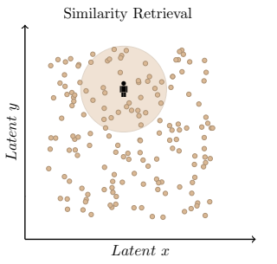
Assessment and evaluation
Performance
Clustering
Further analysis
Latent space
Features
Phenotypes
Categories
Trajectories
Similarity retrieval
Figure 8. Latent space description: Similarity retrieval. The diagram represents a query patient and the area of interest for which patients, which are deemed to be similar, should be retrieved.
B. Hernandez et al – Learning meaningful latent space representations for patient risk stratification: Dengue and other acute febrile illness – Frontier Digital Health (2023)

Slide 38
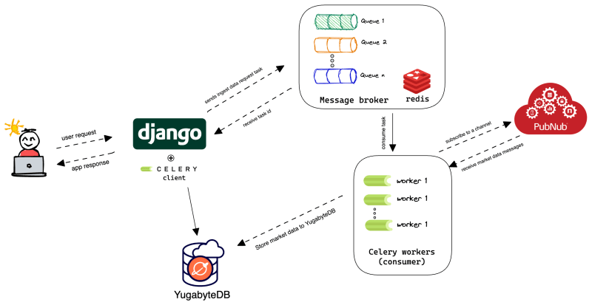
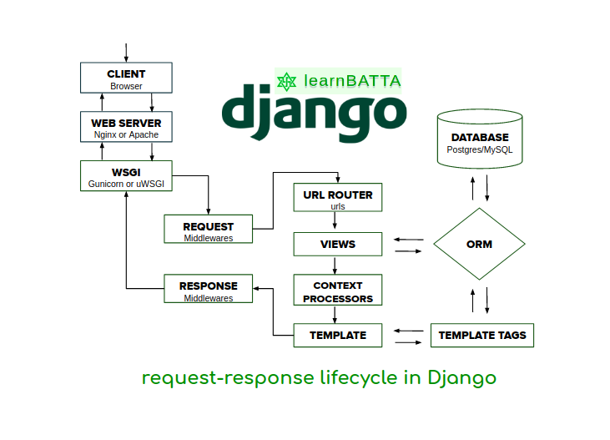
Assessment and evaluation
Performance
Clustering
Further analysis
Latent space
Features
Phenotypes
Categories
Trajectories
Similarity retrieval
Deployment
B. Hernandez et al – Learning meaningful latent space representations for patient risk stratification: Dengue and other acute febrile illness – Frontier Digital Health (2023)

